Slide 1
Made by:
Group B
ECTE 250
Engineering Design and Management 2

Slide 2
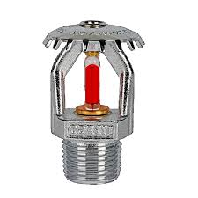
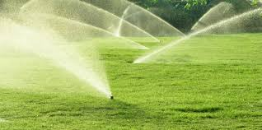
♦ second Idea:
A sensor in the sprinkler can determine the temperature in the forest to prevent fires.
▪ depending on the temperature that the sensor in the sprinkler will detected the sprinkler will work.
That helps to moisturize the air and prevent the fires.

Slide 3
♦
Smart sprinkler:
When we come to think about saving the earth, we need to think about reducing the fair that increase the percentage of co2 in the air.
This sprinkler will work on moistening the air whenever the temperature go above 40C.
We are going to use 2 sensor. first one to determine the temperature and the second sensor will use it to determine the % chance of rain.
Whenever there’s a rain or the temperature is less than 40c the sprinkler will not work.

Slide 4
Start
♦ Flow Chart:
Get the temp.
Get weather data
If temp>=40 C
&&
Chance of rain <25%
No
Keep off
yes
Turn on sprinkler for x min

Slide 5
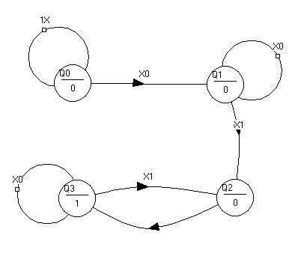
♦ State diagram:
Q0:none
Q1:check weather
Q2: check temp
Q3: turn on the sprinkler

Slide 6
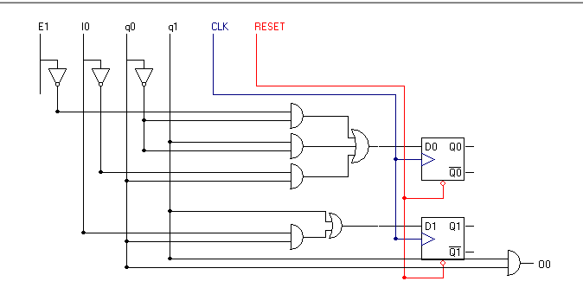

Slide 7
♦ Equipment for second idea:
Part Name | Quantity | Price (AED) Each
Arduino kit | 1 | 275
Sensor (chance of rain) senseweather | 1
Temperature Sensor | 1 | 6.5
74HC74 (Dual D type flip flops) | 2 | 4
74LS08 (Quad 2-input AND gate) | 5 | 4
74LS00 (Quad 2-input NAND gate) | 6 | 4
Total |  | 333.5

Slide 8
♦ UPD transmission to/from the internet:
the data that we are going to get it from the sprinkler through the internet is:
- Get the data on how many time did the sprinkler worked during a weak.

Slide 9
Thank you!
Please ask questions if you have.

